Slide 1
A Mindful Approach to
Pain Management
Elana Rosenbaum, M.S., M.S.W., LICSW
Certified MBSR instructor and Licensed Independent Clinical Social Worker Author: The Heart of Mindfulness-Based Stress Reduction, Being Well (Even When You’re Sick), Here for Now: Living Well with Cancer through Mindfulness
,

Slide 2

MINDFULNESS
A WAY OF PAYING ATTENTION
ON PURPOSE
TO THE PRESENT MOMENT
with KINDNESS and ACCEPTANCE
Jon Kabat-Zinn

Slide 3
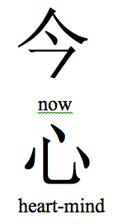
MINDFULNESS =REMEMBERING
NOW
HEARTFELTNESS in the PRESENT MOMENT
6

Slide 4

KEY FACTORS IN MINDFULNESS
INTENTION
ATTENTION
ATTITUDE

Slide 5
HOW DOES MINDFULNESS HELP US OVERCOME SUFFERING?
It gives us the ability to fully experience a situation without being bound by our expectations, our conditioned reactions and perceptions.

Slide 6
WHAT IS YOUR RELATIONSHIP TO PAIN?
YOUR PAST EXPERIENCE
YOUR EXPECTATIONS
YOUR BELIEFS
YOUR THOUGHTS AND FEELINGS

Slide 7
Stop
Take a breath
Open, observe
Proceed

Slide 8

“Breathing in I know I am breathing IN
Breathing out I know I am breathing OUT
Dwelling in the present moment
It is a precious moment.”
Thich Nhat Hahn
What are you aware of NOW?
in Mind? In Body?
Thoughts and Feelings

Slide 9
An unpleasant sensory or emotional experience associated with actual or potential tissue damage. (International Association for the Study of pain) an unpleasant feeling that is conveyed to the brain by sensory neurons
(farlex medical dictionary) an unpleasant emotional experience usually initIated by a noxious stimulus and transmitted over a specialized neural circuit to the cns where it is interpreted as such. (Monheim)
WHAT IS PAIN?

Slide 10
From Robert Rosenbaum, Ph.D
Kaiser Permanente Pain Clinic

Slide 12
Pain is whatever the experiencing person says it is and occurs whenever the experiencing person says it does.
McCaffery and Passero

Slide 13
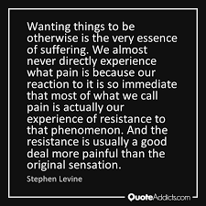
SUFFERING = PAIN X RESISTANCE
If only_____________than I’d be happy

Slide 14
Stimulus CHOICE Response
Between a stimulus and response there is a space. In that space is our power to choose our response. In our response lies our growth and our freedom. —Viktor Frankl
It’s not so much about what happens to you – but rather how you respond to what happens.

Slide 15
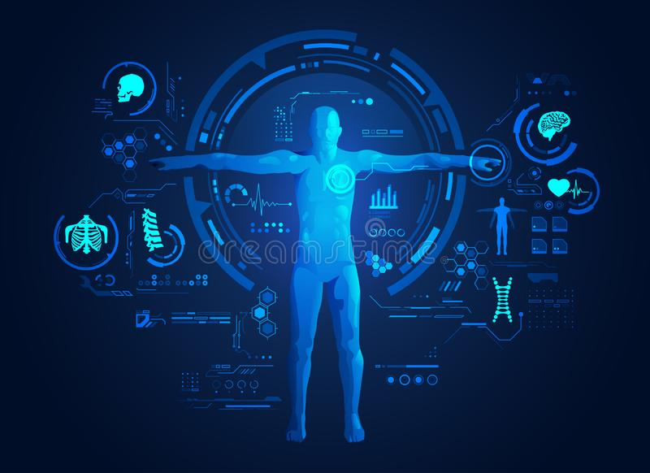
THE BODY
WHAT IS YOUR RELATIONSHIP TO THE BODY?
The Body Scan
What is your relationship to the body?

Slide 16
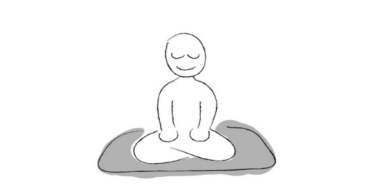
SELF-REGULATION OF ATTENTION
PRESENT MOMENT FOCUS
Mind
Wanders
Mind Wanders
RETURN TO NOW
TRAINING THE MINDFULNESS MUSCLE

Slide 17
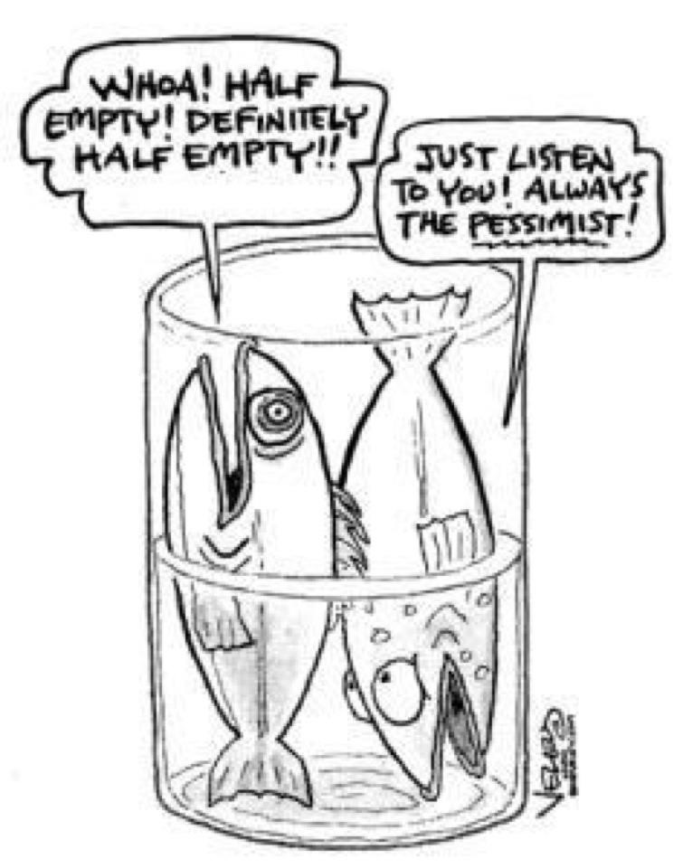
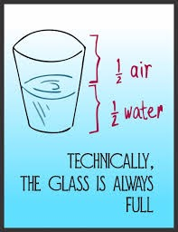
Where do you place your attention? What is your default position?

Slide 18
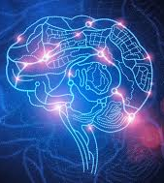
THE STRAIN OF PAIN LIES MAINLY IN THE BRAIN
THE STRAIN OF PAIN SUNG TO THE RAIN IN SPAIN
Neurons that fire together wire together
Donald Hebb, neuropsychologist

Slide 19
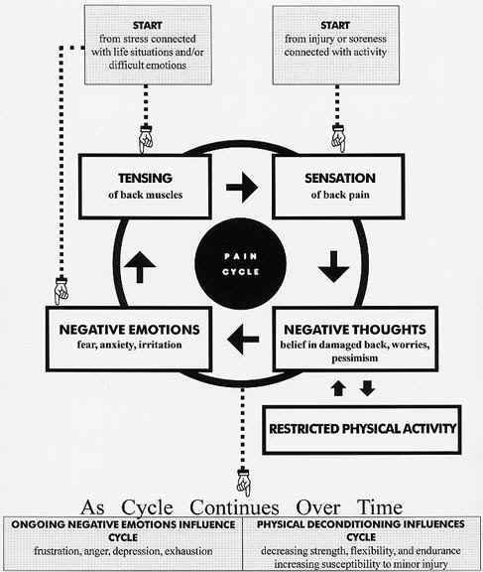
START
stress, life situations,
difficult emotions
e.g. late driving to work on crowded freeway
START
injury or soreness connected with activity
e.g. poor fit of car seat, steering wheel
TENSING
back, neck, facial muscles
clenched hands, jaw
SENSATION
back pain
headache
NEGATIVE FEELINGS
fear, anxiety,
irritation, frustration,
NEGATIVE THOUGHTS
I’ll be late & boss’ll be mad
I must have a slipped disc
I’ll be in pain all day
⬆︎⬇︎
⬆︎⬇︎
BEHAVIORS
grip steering wheel tightly, tailgate, honk, speed
at work, take more Anacin Extra Strength, skip lunch
at home, lie down and skip daily exercise; drink alcohol
As Cycle Continues Over Time
ONGOING NEGATIVE EMOTIONS
effects on relationships with others
escalating feedback loops
ONGOING NEGATIVE PHYSICAL EFFECTS
physical deconditioning increases risk of injury
substance use affects sleep, causes rebound headaches

Slide 20
Stop
Take a breath
Open, observe
Proceed

Slide 21
Moving
Re-thinking
Identifying Types of Dysfunctional Thoughts
  Catastrophizing: “I can’t handle this”
  All-or-Nothing: “Today’s going to be a bad day”
  Overgeneralizing: “I’m always in pain”
Using Thought Record to Counter Dysfunctional Thoughts
  Identifying distortions
  Reminding of the truth
  Talking back, stepping aside
Separating Pain from Distress
  Find examples of high distress/low pain and vice versa
  Rate pain and distress separately in daily pain record
  Practice decreasing distress to increase pain tolerance
  Practice increasing pain tolerance to decrease distress
  Introduce emotional coping strategies
Relating
Focusing
Moving
Noticing
Re-thinking
Enjoying

Slide 22

The Double Arrow Effect

Slide 23
Stop
Take a breath
Open, observe
Proceed

Slide 24
ATTITUDE~PERSPECTIVE
“You can’t stop the birds of suffering from flying over your head but you can stop them from nesting in your hair.” — Chinese proverb
“The one thing that cannot be taken from man is his ability to choose his attitude in any given set of circumstances.” — Viktor Frankl, holocaust survivor, Man’s Search for Meaning
I say to myself, “Yes to life and all that is in it.”
Every day I appreciate being here - alive!
And practice gratitude

Slide 25
COPING WITH EMOTIONS
STEP BACK—BE CURIOUS
  NOTE The TRIGGERING EVENT
BRING AWARENESS TO THE FEELINGTONES (
NOTE HOW THE EMOTION
IS EXPRESSED IN THE BODY
  NOTE THE SENSATIONS
  NOTE THE THOUGHTS
  NOTE THE DURATION
  NOTE WHAT HAPPENS NEXT

Slide 26
RECOMMENDATIONS
Recognize
Acknowledge, Allow & Accept
Investigate
Non-identify, nurture
This is a moment of suffering.
May I bring compassion to my pain.

Slide 27
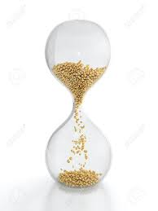
3 STEP BREATHING SPACE
1.OPENING TO INNER AND OUTER EXPERIENCE
Opening to inner and outer experience
2.SINGLE FOCUS
Bringing awareness
to the breath
Doing a Body Scan
3.EXPANDING ATTENTION—BODY AWARENESS

Slide 28
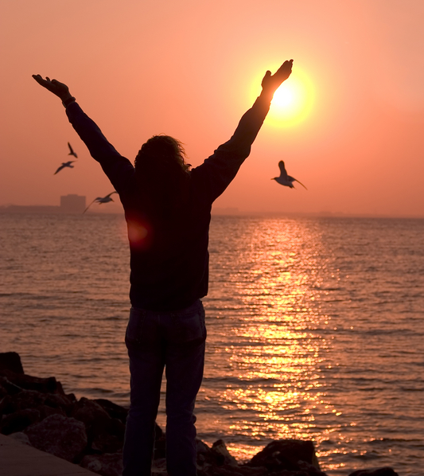
GRATITUDE
Even after all this time
The sun never says to the earth
“You owe me.”
What do you do with a love like that?
It lights up all the earth.
Hafiz

Slide 29
ALLOW
There’s no controlling life.
Try corralling a lightning bolt,
containing a tornado.
Dam a stream and it will create a new channel.
Resist, and the tide
will sweep you off your feet.
Allow, and grace will carry you to higher ground.
The only safety lies in letting it all in –
the wild and the weak; fear,
fantasies, failures, and success.
When loss rips off the doors of
the heart, or sadness veils your
vision with despair, practice
becomes simply bearing the truth.
In the choice to let go of your
known way of being, the whole
world is revealed to your new eyes.
                Danna Faulds from Go In and In

Slide 30
